Slide 1
Conditionals

Slide 2
Let’s First Review What We Learned Yesterday
First we talked about sequences: strings and lists
A string (“”) is a collection of one or more characters and cannot change once it is created which means it is immutable
Lists ([]) are sequences of ordered elements that can change once they are created which means they are mutable
http://net-informations.com/python/flow/default.htm

Slide 3
Let’s Review What We Learned Yesterday
Lists can contain objects with different data types while strings only hold textual data
Elements in a list are accessed by their index
Remember! The first item in a sequence is at index 0
Question: Can someone tell me how you could get more than one element from your list?
http://net-informations.com/python/flow/default.htm

Slide 4
Let’s Review What We Learned Yesterday
We also went over list slicing
my_list[start:stop:step]
Question: Can somebody tell me three ways to add elements to a list?
To remove elements from a list you can use del -deletes items at specific indices, .pop() - deletes an item at a specific index, or .remove() - removes a specified item from the list
http://net-informations.com/python/flow/default.htm

Slide 5
Let’s Review What We Learned Yesterday
List operations such as len(my_list) and [1, 2, 3] + [4, 5, 6] = [1, 2, 3, 4, 5, 6]
Question: Can somebody tell me what would happen if I multiplied a list by 4
Ex: [7, 8, 9] * 4
Lastly we talked about dictionaries: {}, mutable, can contain any type of Python object
http://net-informations.com/python/flow/default.htm

Slide 6
Let’s Review What We Learned Yesterday
For dictionaries, the data values are stored as key:value pairs
Question: How would I get the values in a dictionary?
If myDictionary= {
“key1” : “value1” ,
“key2” : “value2”
}
To update the value of key1:
myDictionary[“key1”]= “newValue”
To add a new key: value pair
myDictionary[“key3”] = “value3”
http://net-informations.com/python/flow/default.htm

Slide 7

Control flow
How the computer makes decisions.
The order in which the code is executed.
Sequence
Selection
Repetition
CODE
Notes:
It controls the way the code is executed.
go over repetition tomorrow

Slide 8
Flow Control - Sequence
Default mode
One after another in order
Depends on the order in which your code appears
Does not skip or repeat instructions
Wake up
Brush Teeth
Eat
http://net-informations.com/python/flow/default.htm

Slide 9
Flow Control - Selection
Condition?
False
Execute based on a condition or a test
Used to add decision-making to programs
Can have multiple conditions and multiple outcomes
True
Statement
Notes:
If it is raining I need my umbrella before leaving

Slide 10

Booleans
Another variable type (bool)
Only 2 values: True or False
Python returns a boolean when you compare two values
Example:
print(7>5) → True
print(7<5) → False

Slide 11
Comparison Operators
In addition to arithmetic operators, Python also has comparison operators:
Operator | Meaning
< | less than
<= | less than or equal to
> | greater than
>= | greater than or equal to
!= | not equal to
== | equal to

Slide 12

= and == operators
= is the assignment operator
Example
a_greeting = “hello”
== is the equal to sign
Example
1 == 1 → True

Slide 13
In notebook 03_Conditionals, complete the following section:
1 - Booleans and Comparison Operators
Notes:
Stop/Start Here

Slide 14
Conditional Statements
Give us the ability to check conditions and change the behavior of a program
Condition?
False
True
Statement

Slide 15
If statements
if <condition>:
<do something>
Note the syntax! Indentation matters!

Slide 16
if/elif/else statements
if <condition>:
<do something>
elif <condition>:
<do something>
else:
<do something>

Slide 17
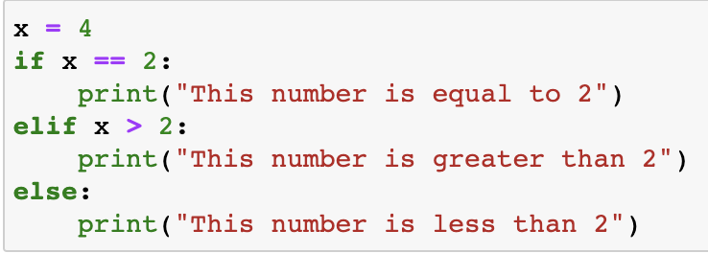
Example - What will the output be?
Notes:
Elif conditions are mutually exclusive, that is the first condition that is true triggers the execution of the statement

Slide 18
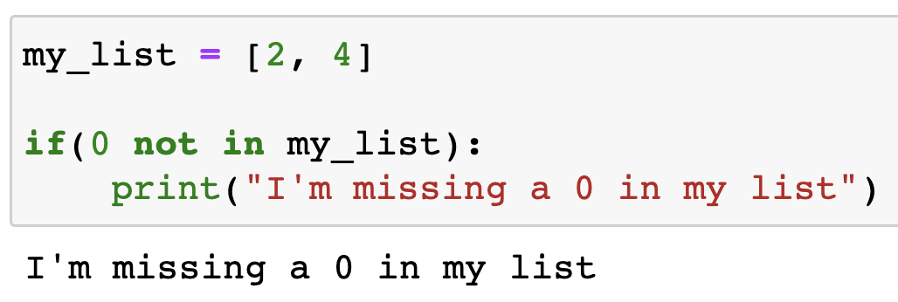
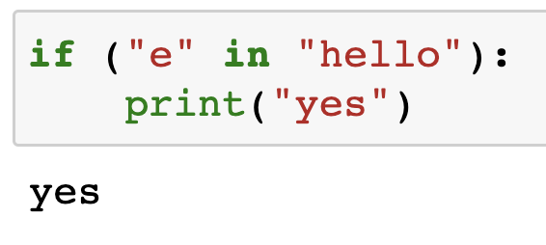
Membership Operators
in and not in operators
Check if a value exists in a sequence or not
Examples:

Slide 19
In notebook 03_Conditionals, complete the following section:
2 - Conditional Statements
When you are done, complete the Exit Ticket!
If you have extra time, you can try the challenge.

